Slide 1

TRAFFIC LIGHT CONTOLLER
Name : Mor Vrushabh Bharatbhai
Roll No. : 220002055
Email ID : ee220002055@iiti.ac.in

Slide 2
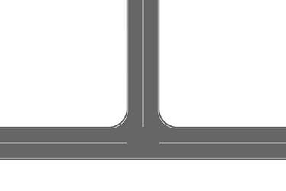
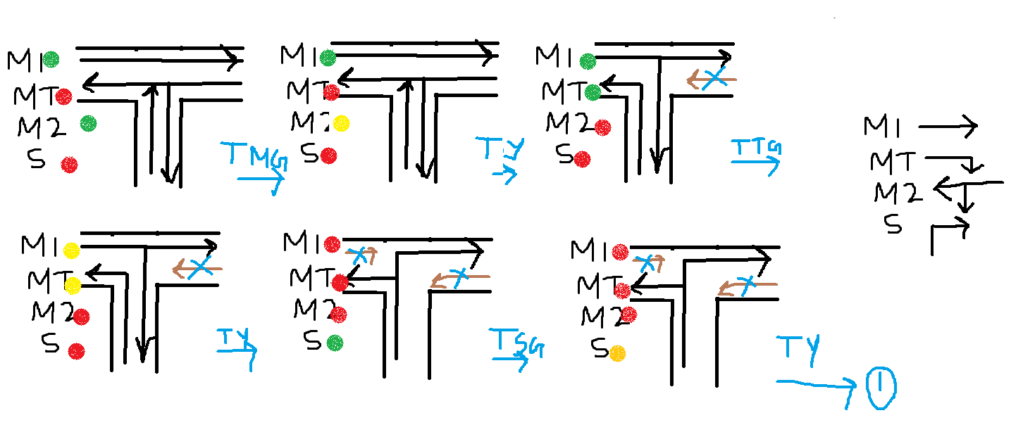
Main Road
Routes Defined:
Side Road
The six cases present here eventually turn to the six states.

Slide 3
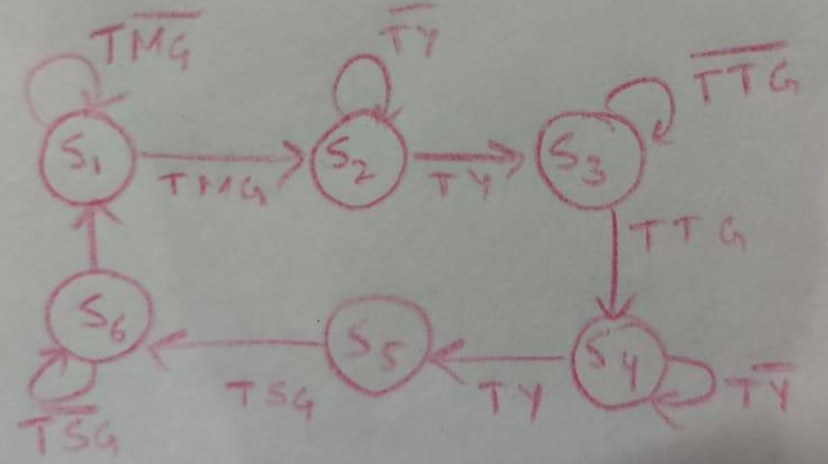
State Diagram:
TMG : 7 sec
TY : 2 sec
TTG : 5 sec
TSG : 3 sec
The Traffic Light Controller is basically acting as a Mealy Finite State Machine as the next state is dependent on the input as well as the previous states.

Slide 4
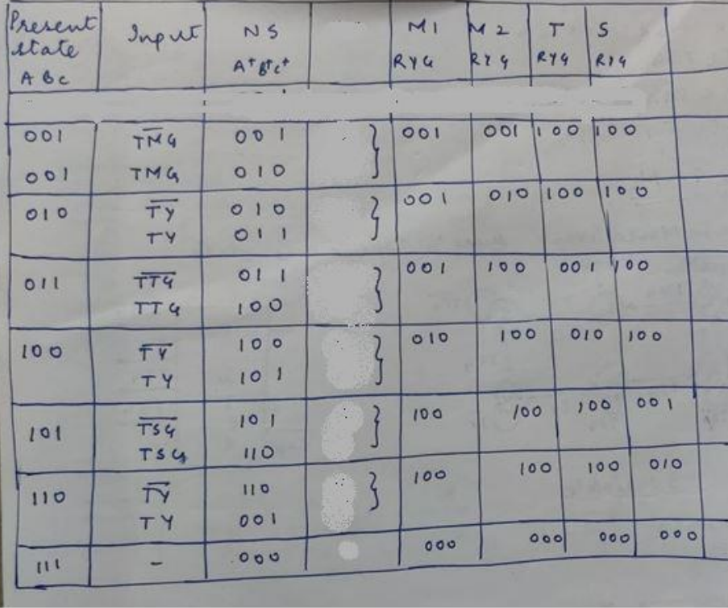
State Table:
The state table is drawn from the state diagram.

Slide 5
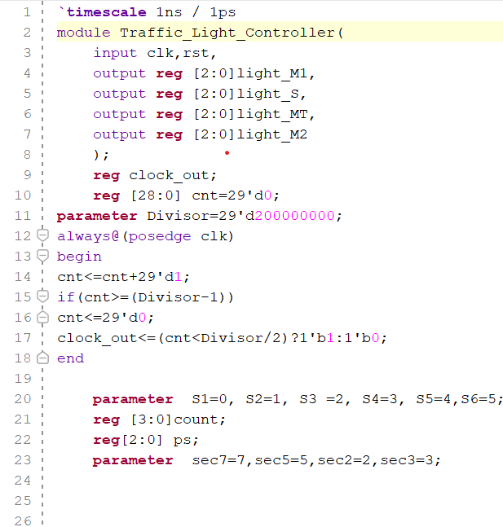
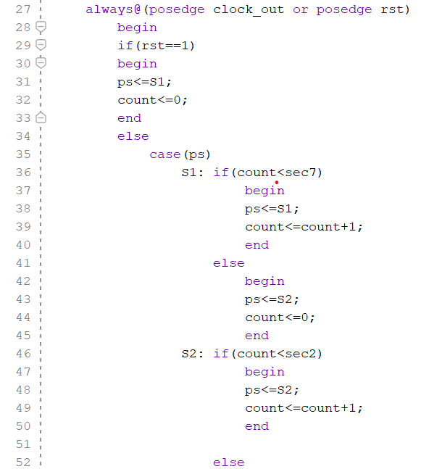
Verilog Code:

Slide 6
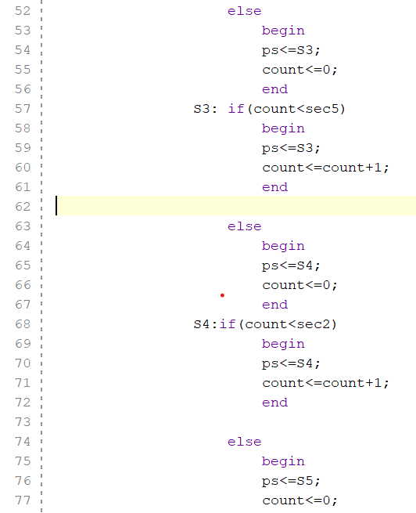
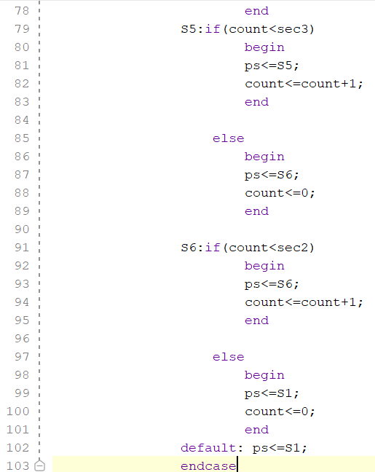
Verilog Code:

Slide 7
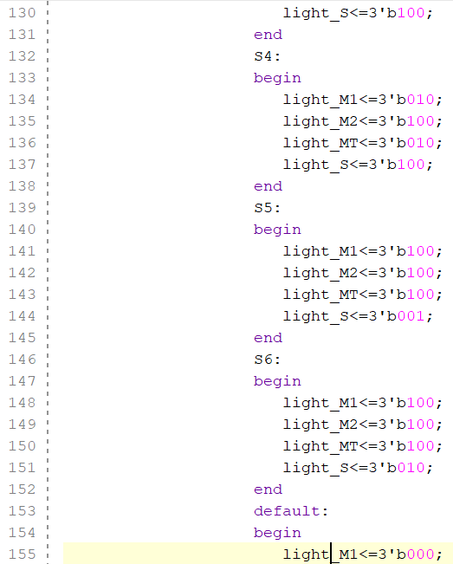
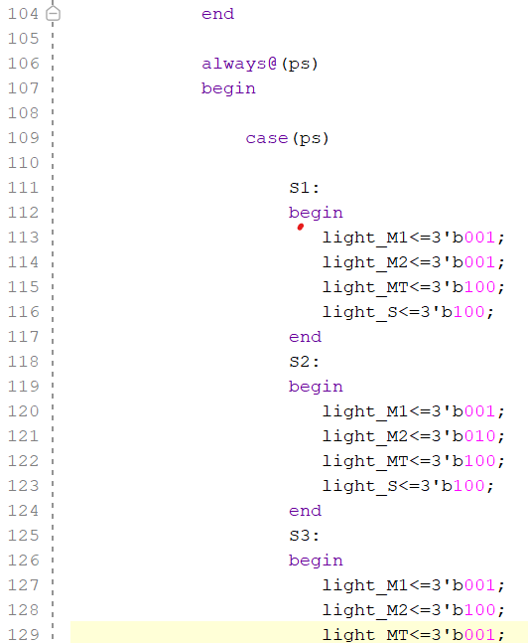
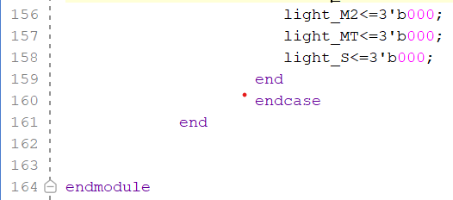
Verilog Code:

Slide 8
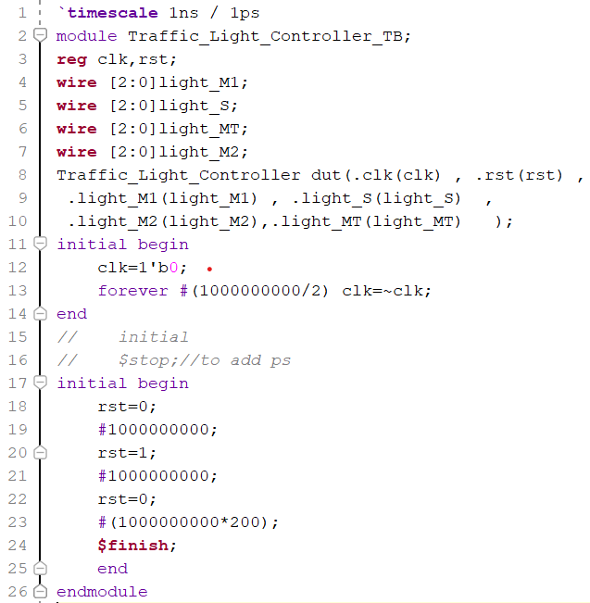
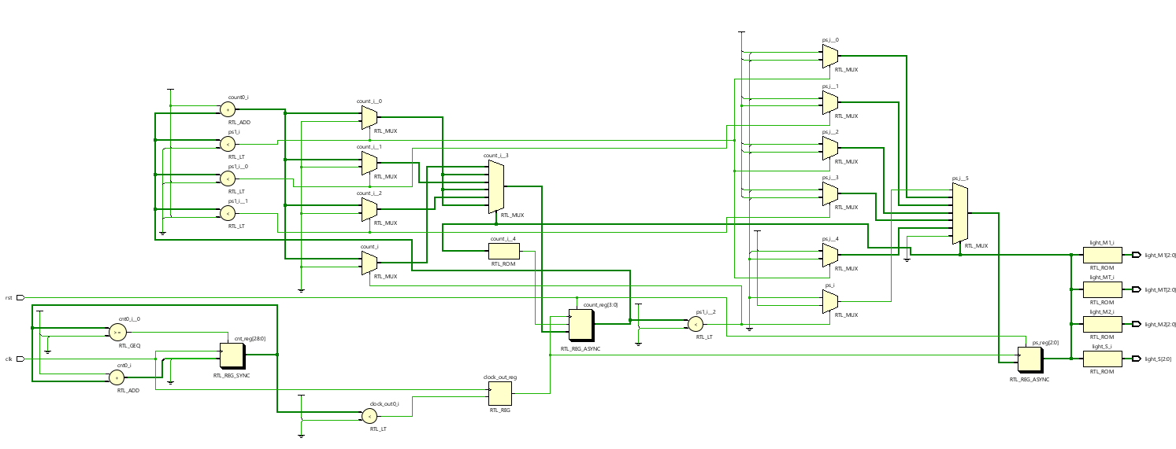
Testbench:
Schematic:

Slide 9
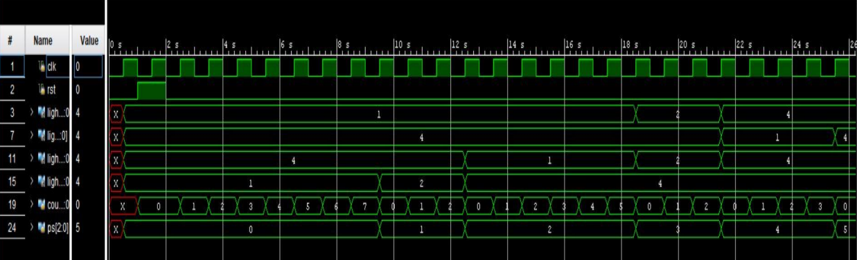
Output Waveform:

Slide 10


